Slide 1
Web of Things in the Smart City
Michael McCool
June 2021

Slide 2




W3C Web of Things (WoT)
W3C WoT Working Group goal: Adapting web technologies to IoT
Published: Thing Description (TD) metadata format
TD describes the available interactions (network API) of a Thing
In Progress: TD 1.1 Update, Thing Models, Discovery, Profiles
How to obtain TDs? How to ensure interoperability?
App
App
App
App
App
App
WoT API
WoT API
WoT API
{ properties, actions, events }
MQTT
KNX
TLV
ECHONET
Bearer
EXI
HTTP
OAUTH2
WS
XML
MQTT
KNX
TLV
ECHONET
Bearer
EXI
JSON
Modbus
CBOR
OPC-UA
API Key
HTTP
OAUTH2
CBOR
WS
XML
BACnet
AMQP
JSON
Modbus
BACnet
OPC-UA
API Key
AMQP

Slide 3

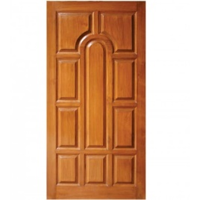

WoT Thing Descriptions
{
"@context": [
"https://www.w3.org/ns/td",
{ "iot": "http://iotschema.org/" }
],
"id": "urn:dev:ops:32473-WoTLamp-1234",
"title": "MyLEDThing",
"description": "RGB LED torchiere",
"@type": ["Thing", "iot:Light"],
"securityDefinitions": ["default": {
"scheme": "bearer"
}],
"security": ["default"],
"properties": {
"brightness": {
"@type": ["iot:Brightness"],
"type": "integer",
"minimum": 0,
"maximum": 100,
"forms": [ ... ]
}
},
"actions": {
"fadeIn": {
...
WHAT the possible choices are
Properties
Events
Actions
HOW to interact with the Thing
Protocol operations and options
Data schemas and content types
Security requirements
Pull
Handle = Affordance
What?
How?
Door = Thing
Open
Turn

Slide 4
Usage Patterns

Slide 5
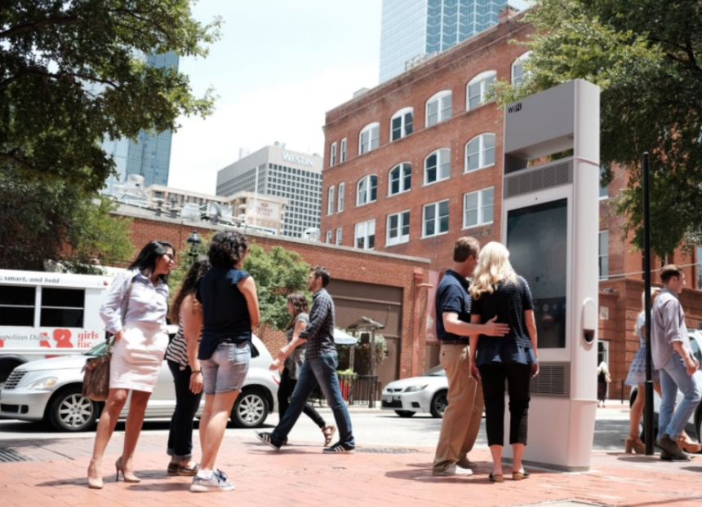


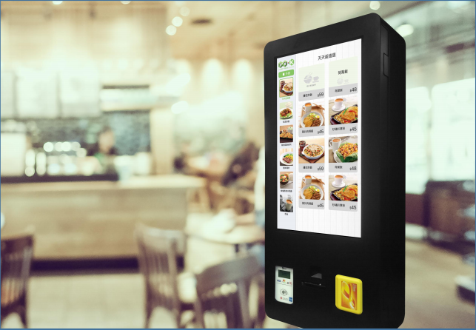
Smart City Use Cases
Visitor Guidance
Energy Management
Others
Law Enforcement
Parking
Accessibility
Traffic and Logistics
Public Transportation
Air Quality and Weather
Cultural Space Mgmt
Construction Services
Land Management
Emergency Services
Water Management
Hybrid Ruralization
Health
Retail Services

Slide 6
Contacts
https://www.w3.org/WoT
Dr. Michael McCool
Principal Engineer
Intel
Technology Pathfinding
michael.mccool@intel.com
Dr. Sebastian Kaebisch
Senior Key Expert
Siemens
Technology
sebastian.kaebisch@siemens.com

Slide 7
Backup

Slide 8
Image Credits
Solar Installation Vietnam: By Intel Free Press - https://www.flickr.com/photos/intelfreepress/7169063498/sizes/o/in/photostream/, CC BY 2.0, https://commons.wikimedia.org/w/index.php?curid=28011974
Telemedicine Consult: By Intel Free Press - https://www.flickr.com/photos/intelfreepress/6948764580/sizes/o/in/photostream/, CC BY 2.0, https://commons.wikimedia.org/wiki/File:Telemedicine_Consult.jpg

Slide 9
Documents and Resources
New/Updated Normative Documents in Draft Status:
Architecture 1.1: https://github.com/w3c/wot-architecture
Thing Description 1.1: https://github.com/w3c/wot-thing-description
Discovery: https://github.com/w3c/wot-discovery
Profiles: https://github.com/w3c/wot-profile
New/Updated Informative Documents in Draft Status:
Binding Templates: https://github.com/w3c/wot-binding-templates
Scripting API: https://github.com/w3c/wot-scripting-api
Use Cases and Requirements: https://github.com/w3c/wot-usecases
Other Resources:
Web Site: https://www.w3.org/WoT/

Slide 10
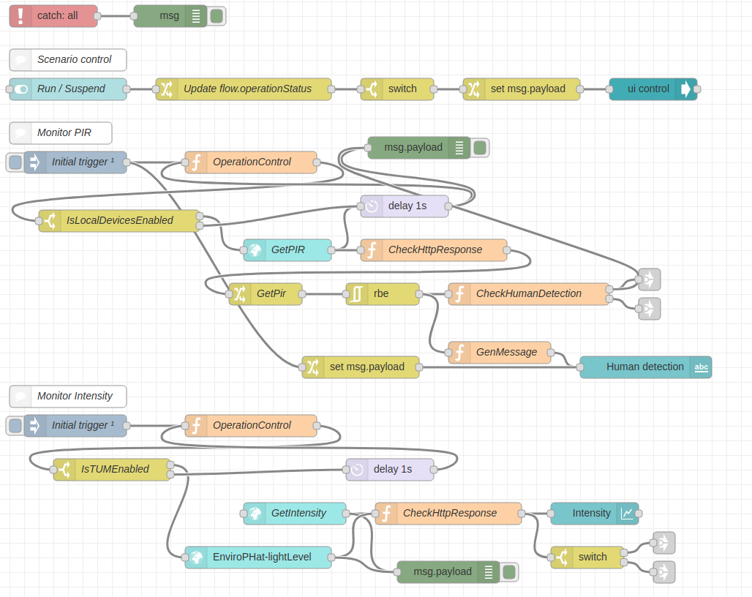

WoT Orchestration
node-wot/Scripting API
Node-RED/node-gen
WoTHelpers.fetch( "coap://localhost:5683/counter" ).then( async (td) => {
// using await for serial execution (note 'async' in then() of fetch())
try {
let thing = await WoT.consume(td);
console.info( "=== TD ===" );
console.info(td);
console.info( "==========" );
// read property #1
let read1 = await thing.readProperty( "count" );
console.info( "count value is" , read1);
// increment property #1 (without step)
await thing.invokeAction( "increment" );
let inc1 = await thing.readProperty( "count" );
console.info( "count value after increment #1 is" , inc1);
// increment property #2 (with step)
await thing.invokeAction( "increment" , {'step' : 3});
let inc2 = await thing.readProperty( "count" );
console.info( "count value after increment #2 (with step 3) is" , inc2);
// decrement property
await thing.invokeAction( "decrement" );
let dec1 = await thing.readProperty( "count" );
console.info( "count value after decrement is" , dec1);
} catch(err) {
console.error( "Script error:" , err);
}
}).catch( (err) => { console.error( "Fetch error:" , err); });

Slide 11
Current WoT WG Charter Work Items
Architectural Requirements, Use Cases, and Vocabulary
Understand and state requirements for new use cases, architectural patterns, and concepts.
Link Relation Types:
Definition of specific link relation types for specific relationships.
Observe Defaults:
For protocols such as HTTP where multiple ways to implement "observe" is possible, define a default.
Implementation View Spec:
More fully define details of implementations.
Interoperability Profiles:
Support plug-and-play interoperabilty via a profile mechanism
Define profiles that allow for finite implementability
Thing Models:
Define how Thing Descriptions can defined in a modular way.
Complex Interactions:
Document how complex interactions can be supported via hypermedia controls.
Discovery:
Define how Things are discovered in both local and global contexts and Thing Descriptions are distributed.
Identifier Management:
Mitigate privacy risks by defining how identifiers are managed and updated.
Security Schemes:
Vocabulary for new security schemes supporting targeted protocols and use cases.
Thing Description Vocabulary:
Extensions to Thing Description vocabulary definitions.
Protocol Vocabulary and Bindings:
Extensions to protocol vocabulary definitions and protocol bindings.

